Slide 1

“I am more of a ‘bookish’ kind of a girl and frequently sit up late in the class room or the library. Usually, I take a safe route home, but then, who can really tell if it is safe eh?”
Stacy
studious
Personal Information
Age: 19 years old
Occupation: Full time student.
Lives: In a dorm on campus.
Technical Proficiency: Uses her laptop frequently for studying and her phone for texting.
Nocturnal Information
Frequently visit: the library or a study group
Time of returning home: Around 9 pm.
Streets to avoid: Streets that are lonely at night.
Streets that are safe: Places that are crowded and near a main road.
Feelings and Concerns: She wants to know the safest route home.
Product Goal for her: To provide her with a solution which can help her in deciding which route she can take while returning home from school.
Personal Profile:
Stacy is a typical college student who goes to the university to attend lectures and to study for her class work. Many a times, she had to sit back late in the library or the class room completing her assignments with her group mates. As she stays in a dorm nearby, she usually walks home from school along a quiet lonely road.
Stacy is concerned of dangers that exist on the street late at night. She is even willing to take a longer route home, provided it is crowded and well-lit or on a main road. But she isn’t aware of such places and so, she frequently return home early from school. But, she doesn’t want to disrupt her current study schedule. When faced with a dangerous situation, she would try to run away and scream for help or call 911 emergency. However, she wants to stay safe and so, would like to have someone or something help her out when returning home late at night.
primary persona: People who are out studying late at night represent 70% of potential users of our product.

Slide 2
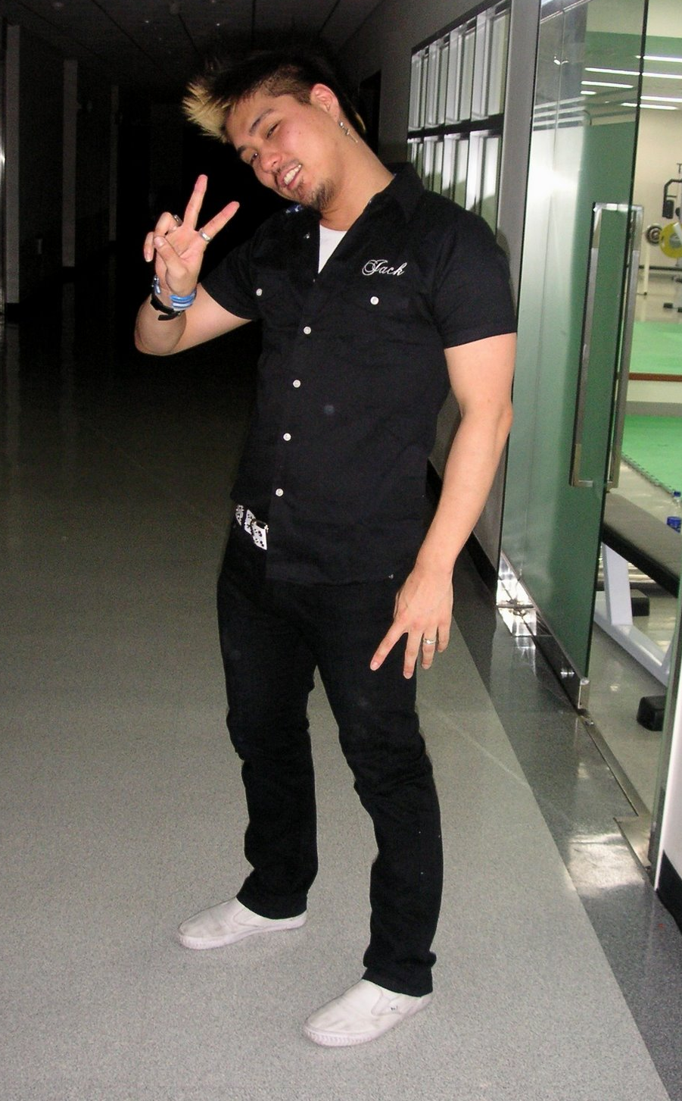
“I party frequently and it gets crazy sometimes. So, I return home at odd timings after a late night but, I am not scared or anything. Just, would love to be informed if a situation breaks loose.”
Warren
wild
Personal Information
Age: 26 years old
Occupation: Student with some part time experience on-campus.
Lives: Of campus in an Apartment on the Ave.
Technical Proficiency: Not much into technology other than his phone.
Nocturnal Information
Frequently visit: local pubs and night clubs
Time of returning home: At 12 am or later.
Areas to avoid: Streets with high crime rate.
Areas that are safe: Doesn’t really know. All seem safe to him
Feelings and Concerns: He wants to be well informed while out at night.
Product Goal for him: To improve communication and support from the authorities regarding any criminal activities happening in the locality, so that he can avoid any form of interaction with the criminal.
Personal Profile:
Warren is an extrovert in nature and loves to party and visit clubs often. He is also a student at the University and works part time on campus. When he is free, he spends a lot of his time out resulting in him staying there late in the night. Currently, Warren is used to returning home late and has no qualms regarding any form of danger lurking nearby.
Warren is a kind of individual who does not fear of being out late and won’t change his habits or alter his lifestyle in order to be safe. He has even confessed that he would fight back when assaulted, if the criminal didn’t have any weapon on him. Also, he normally does not carry any valuables with him when returning home late. However, he wishes to be informed of any criminal activity happening around his locality, so that he can avoid such places at night.
Secondary persona: People who are out partying late at night represent 50% of potential users of our product.

Slide 3

“My job is tiring and demands me to work late, but that really isn’t an issue for me. I am more concerned of the proliferation of crime in the neighborhood. We should rather do something about that.”
Peter
professional
Personal Information
Age: 35 years old
Occupation: Works for a large IT company.
Lives: In an apartment on Roosevelt Ave.
Technical Proficiency: Uses a smart phone to keep him informed. Also possesses a tablet.
Nocturnal Information
Frequently visit: the office or the bar
Time of returning home: Around 11 pm.
Areas to avoid: Deserted streets with shady people.
Areas that are safe: Places that are well-lit and near a main road.
Feelings and Concerns: He wants to contribute actively in fighting crime in the city.
Product Goal for him: There should be some collective media which helps in taking an offensive mode of attacking crime along with the defensive mode of helping people stay safe.
Personal Profile:
Peter is a professional who often returns home tired late at night after being stressed with work in the office. After a long day of work, the last thing he wants is to be a victim of a crime. He is frustrated with the increase in criminal activities happing in the University District, and so, wants to do something about it.
Peter is disconcerted of crimes happening in his locality. He feels that there is a dire need of law and order in the town and wants its citizen to rise up against it. He feels that everyone’s contribution in attacking crime can cause a tremendous impact on reducing criminal activities happening around town. However, he even suggests not to act foolishly and take on criminals head-on, but rather, through the use of some sort of collective media that can bring people together virtually against crime.
Secondary persona: People who are out working late at night represent 35% of potential users of our product.

